Slide 1
Advance Internship@Clevered MindDoc App
App User Manual
Author: Varya Soni

Slide 2
Table of Contents
Acknowledgement
About Me
About my Internship with Clevered
About App
How do I use the App?
Option Name
Contact Person

Slide 3
Acknowledgements
I am so grateful that my Parents, Clevered,
Mentors, Group Members, Friends, Sites
etc. took the time to teach me. Thank you
for taking out time to teach me and help
me with internship and crash course

Slide 4
About Me..
My name is Varya Soni.
I am in 8th grade.
I study in Delhi Public School Dwarka
Expressway
I live in Gurgaon, Haryana.
My hobbies are to read and learn
about Space and Universe.
My dream is to become a space
scientist in NASA and work for NASA
I would love to make a satellite and
send it beyond the Kuiper Belt.
Student’s Introduction

Slide 5
About My Internship with Clevered..
Your internship experience with Clevered
I had a very great experience as I never used
Python before and using it for the first time
was a little bit challenging but my teacher
helped me a lot.
Badges Earned
Rock Star for Wonderful efforts in project completion
Rockstar for attentiveness

Slide 6
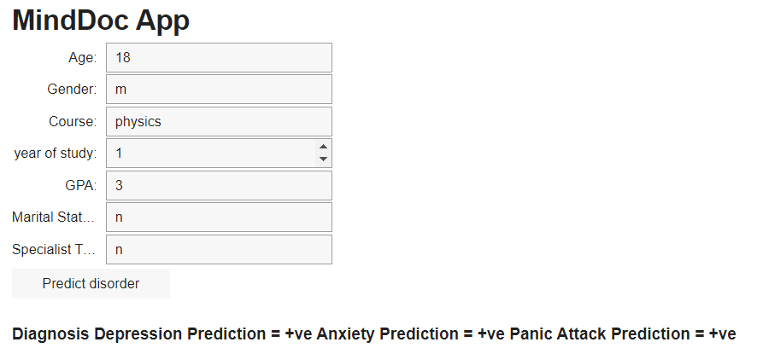
About App..
My App’s name is MindDoc App.
a multiclass classification model that can diagnose Depression, Anxiety and Panic Attack in
college students of different courses.

Slide 7
How do I use the App?
Age
Accepts the age of the patient.
Range that gives the most accurate results: 17-25
Gender
Accepts the gender of the patient.
Accepts values as “male” or “Male” or “m” or “M” or any other equivalent.
Course
Accepts course taken by the patient.
Accepts values as “Mat” or “mat” or “math” or “mathematics” or any other equivalent.
Year of Study
Accepts the patient’s current year of study.
Range that gives the most accurate results: 1-6

Slide 8
Continued
GPA
Accepts the patient’s Grade Point Average (GPA).
Range that gives the most accurate results: 0.00 – 4.00
Marital Status
Accepts the marital status of the patient.
Accepts values as “yes” or “Yes” or “y” or “Y” any other equivalent.

Slide 9
Option Name
(This will be repeated for each option of the App)
Any special considerations/ dependencies/risks while using the option
Steps to use the same
Stable Internet
Install the needed Libraries
Please use Google Colab.

Slide 10
Contact Person
soni.varya24@gmail.com

Slide 11
Thank you!

